Slide 1

CS FYP weekly Presentation
Caleb Mok
2689719m
6/11/2024

Slide 2
What I had prior and currently trying to do
I’ve started work on the prototype, created a unity project and set up shared version control and repository.
A basic MOSCOW board was also made, further population still needed.
I also managed to log into the lab machines but I’m still trying to get the IT department to download the software that I need for my project. I’ve contacted them through SOCS helpdesk, but it is unsure whether my request was granted.

Slide 3
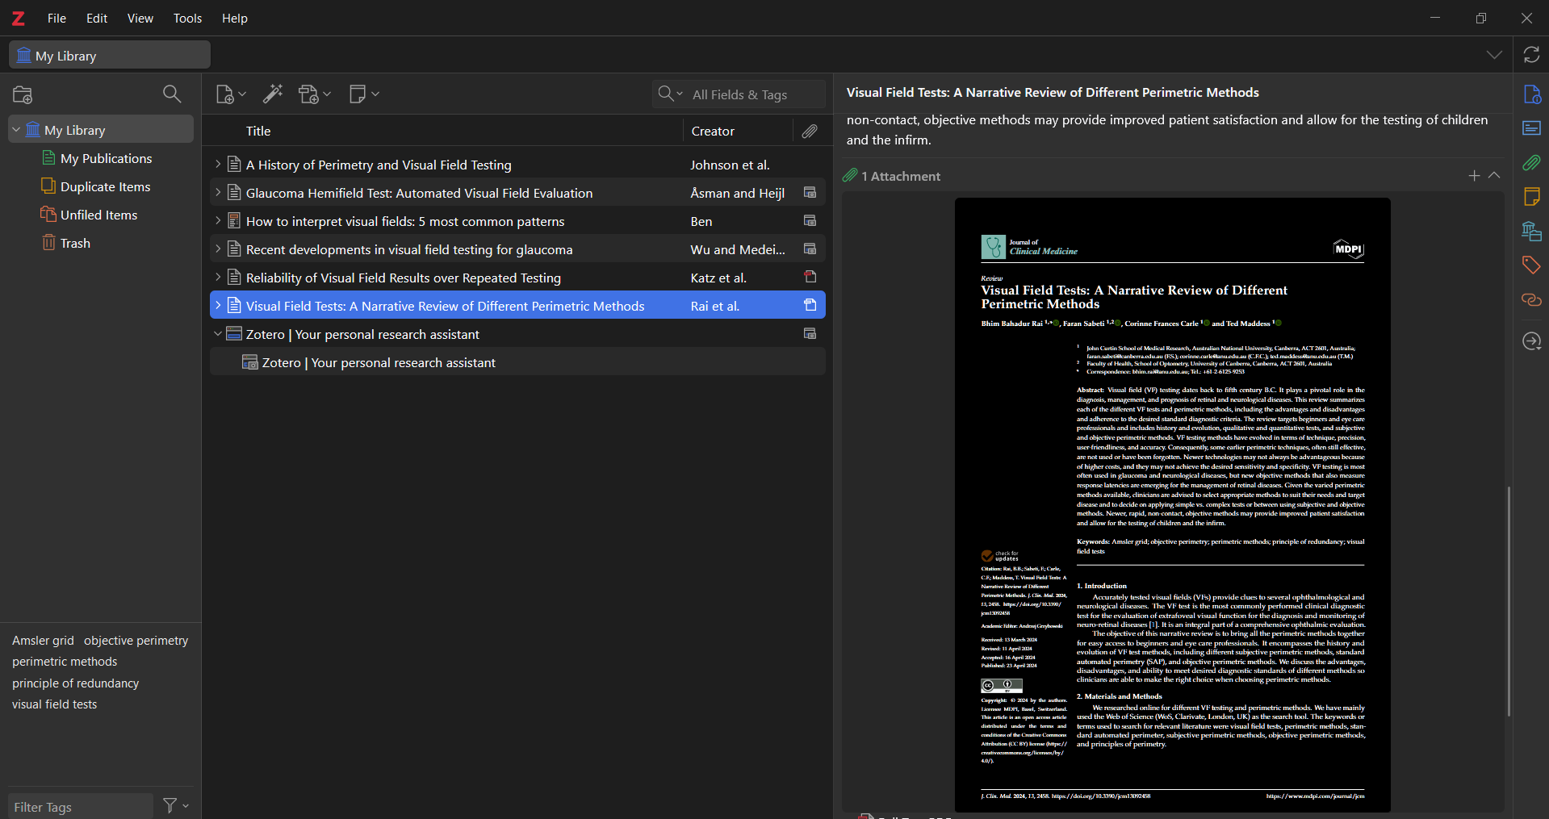
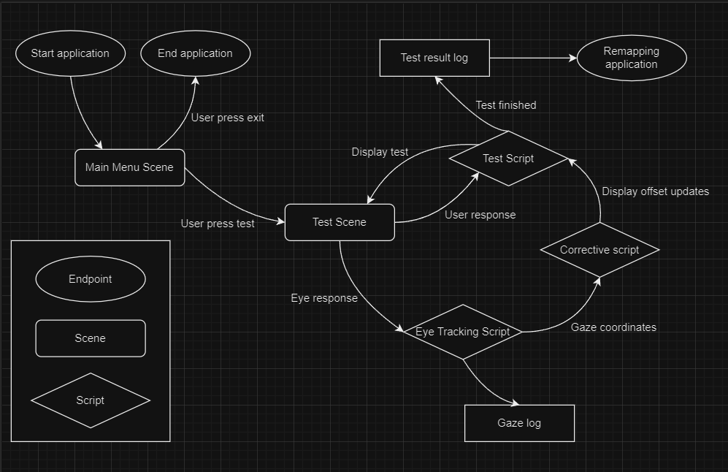
What I achieved this week
I’ve reorganized my literature review, and successfully set up a reference manager (Zotero) to link with Overleaf for easier referencing in the future. I’ve also added a few papers that I’ve briefly read through and deemed important into my review. Some papers I’ve not added into the review, but they are saved in Zotero, and I will analyse them further.
I’ve also started work on making a basic high-level process flow diagram for my project, designed different scenes I expect my project to have and also the scripts needed to run the project.

Slide 4
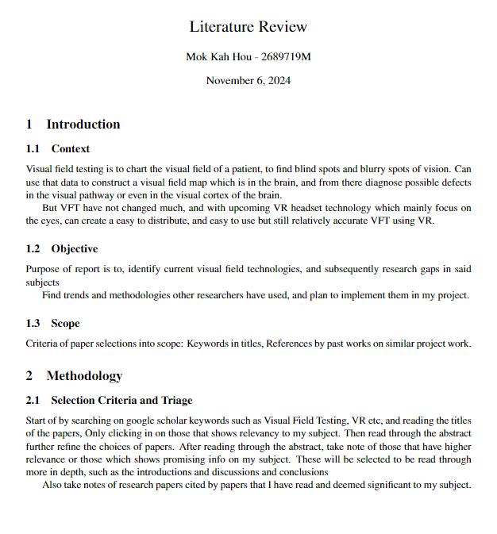
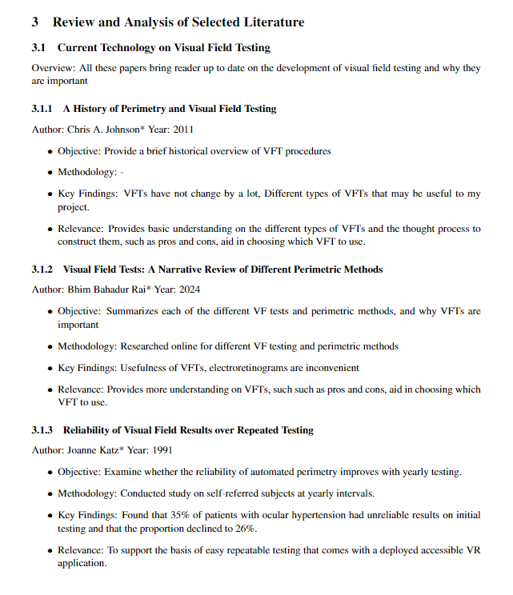

Slide 5
What I plan to do next
I plan to continue reading more research papers and add them into my literature review. I’ll also add more task into MOSCOW board when I notice them.
Refine the process flow diagram to be more in-depth and make an ER diagram based on that, followed by setting up a database.
Maybe start writing basic script to show proof of concept generating flashing dots on screen.
It is also vital for me to get the VR headset running so I can start testing my application.
After that I’ll try running past project to gain more insight, and take note of any useful features and possible improvements.

Slide 6
Literature Review

Slide 7
What I achieved this week
I’ve reorganized my literature review, and successfully set up a reference manager (Zotero) to link with Overleaf for easier referencing in the future. I’ve also added a few papers that I’ve briefly read through and deemed important into my review. Some papers I’ve not added into the review, but they are saved in Zotero, and I will analyse them further.
I’ve also started work on making a basic high-level process flow diagram for my project, designed different scenes I expect my project to have and also the scripts needed to run the project.

Slide 8
What I am trying to do

